Slide 1

SQL PROJECT
FOOTBALL DATABASE
Heitor - Adam

Slide 2
TABLE OF CONTENTS
01
02
03
Project Overview
ER Diagram
Statistics
04
05
06
Team Demographics
Additional Statistics
Summary
Nationality, Immigrants per league & continent
Youngest & Oldest players
Players, Continents, Sectors

Slide 3
PROJECT OVERVIEW
We utilized the Kaggle database featuring the top five European football leagues.
The dataset comprises 10 tables, including seasons, matches, referees, leagues, stadiums, scores, players, teams, coaches, and standings.
It contains data on 1,752 matches across five leagues, covering 3,150 players from 96 teams during the 2023-2024 season.
Our analysis was conducted using MySQL Workbench and VS Code, through which we extracted valuable statistics and insights from the data.

Slide 4
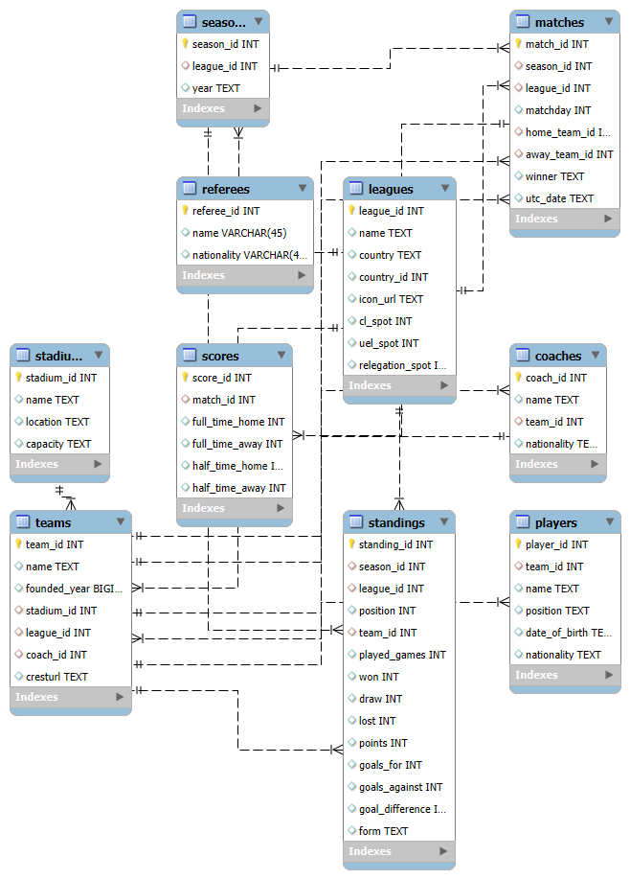
ER Diagram

Slide 5


PLAYERS
Makoto Hasebe
Francesco Camarda
Already in his 40’s, the japanese midfielder played his last season for VfB Stuttgart.
At only 15 years and two months, the italian forward became the youngest player to ever play in Serie A

Slide 6
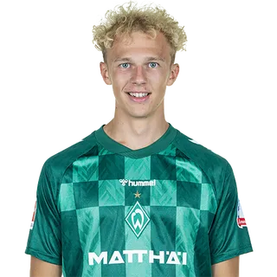
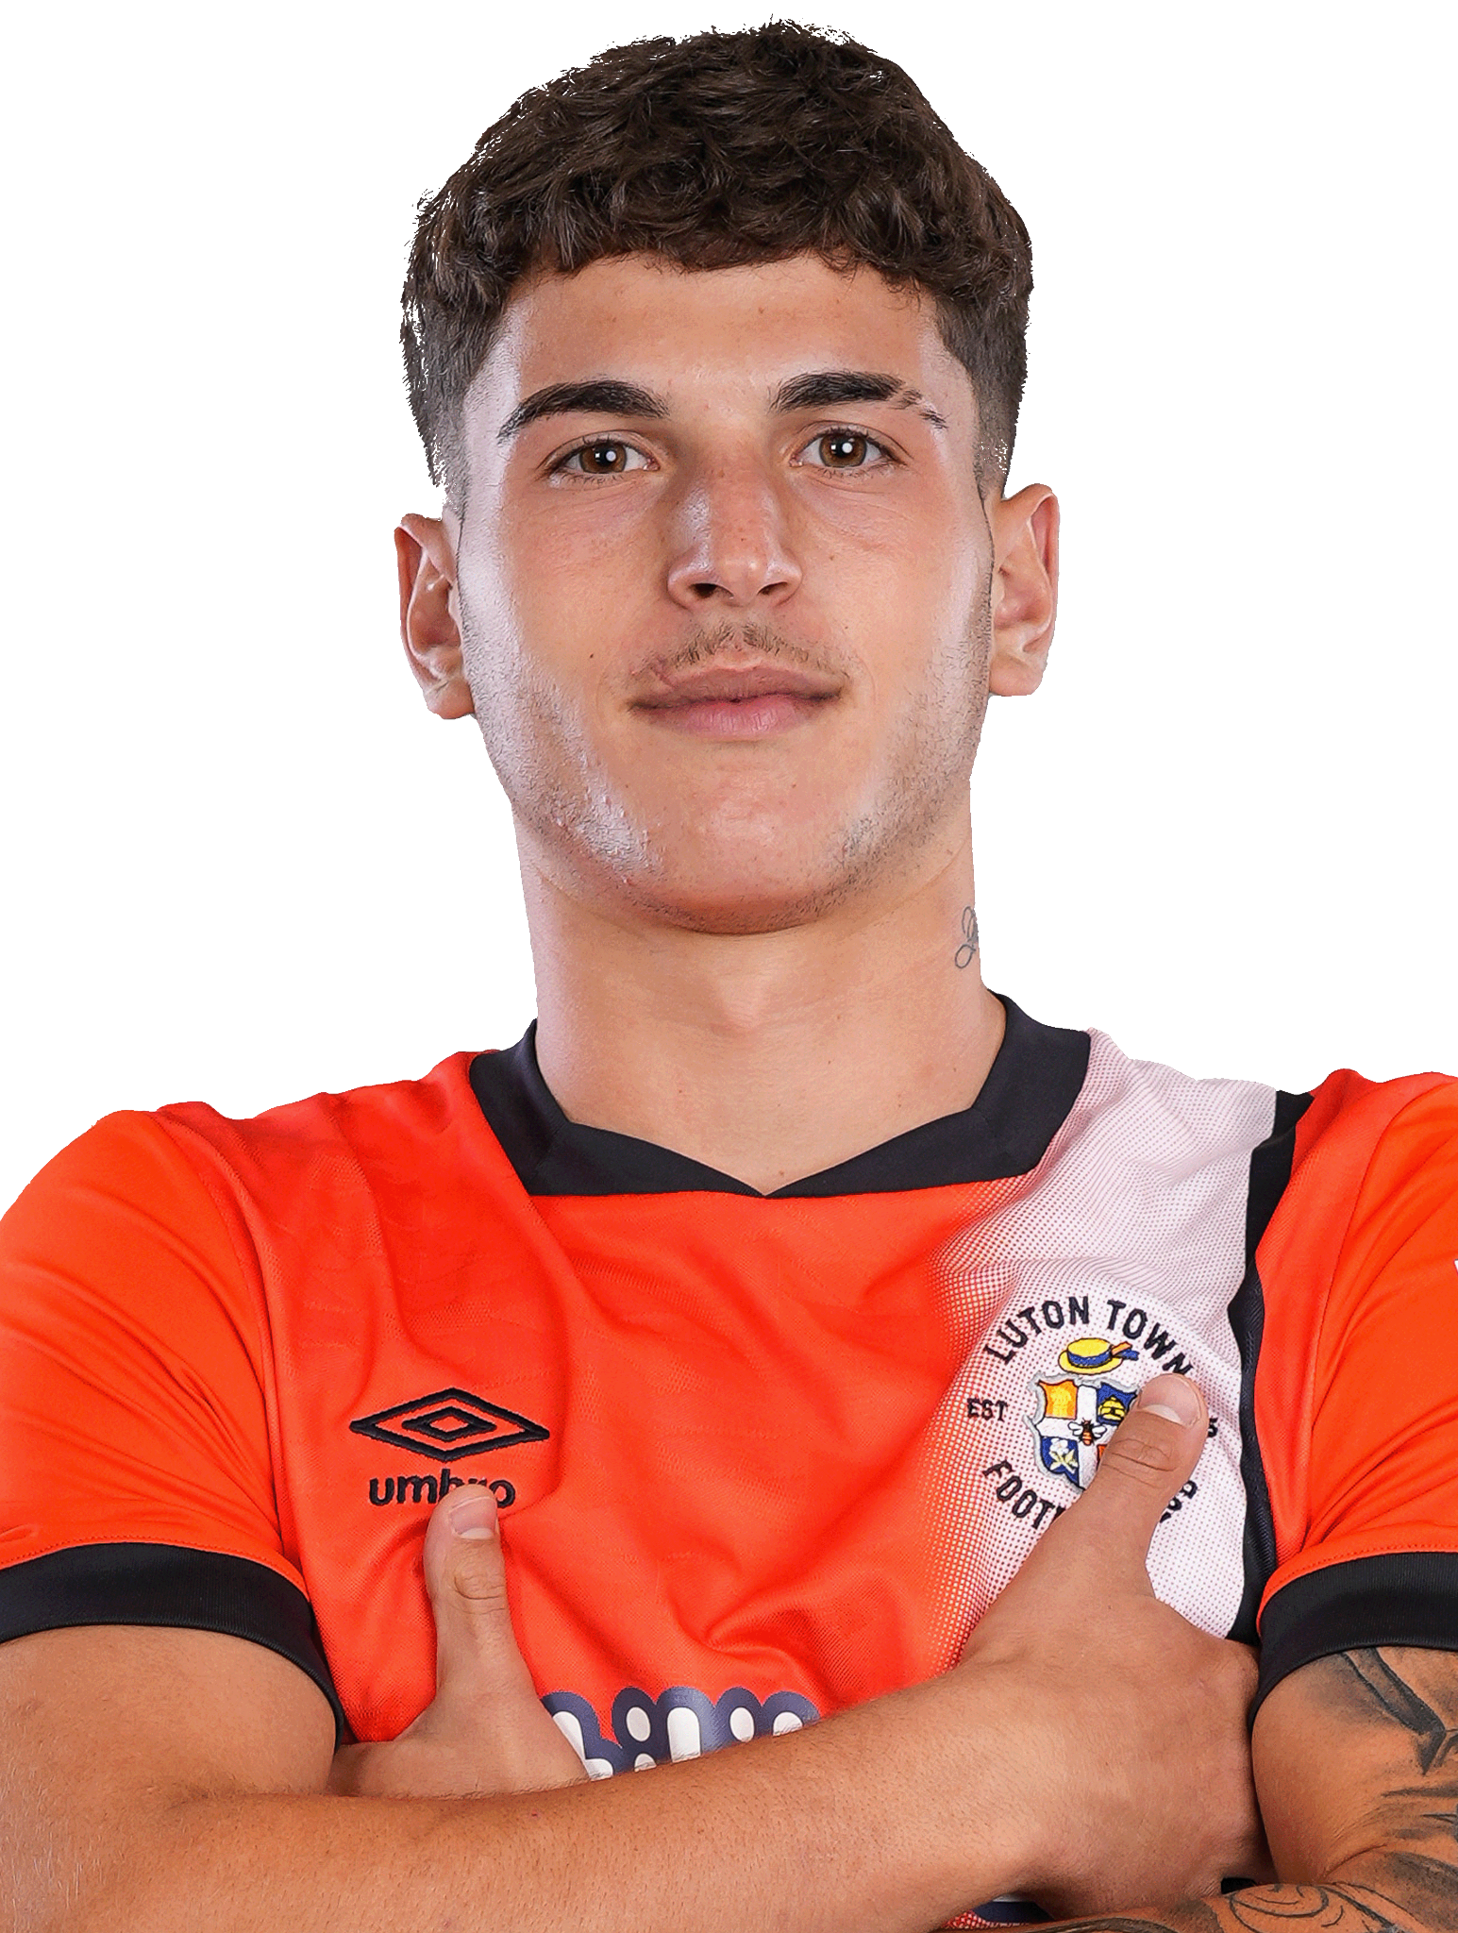
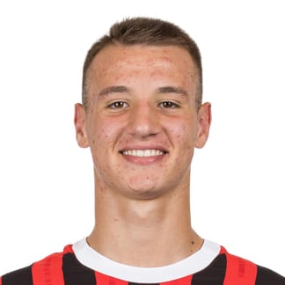
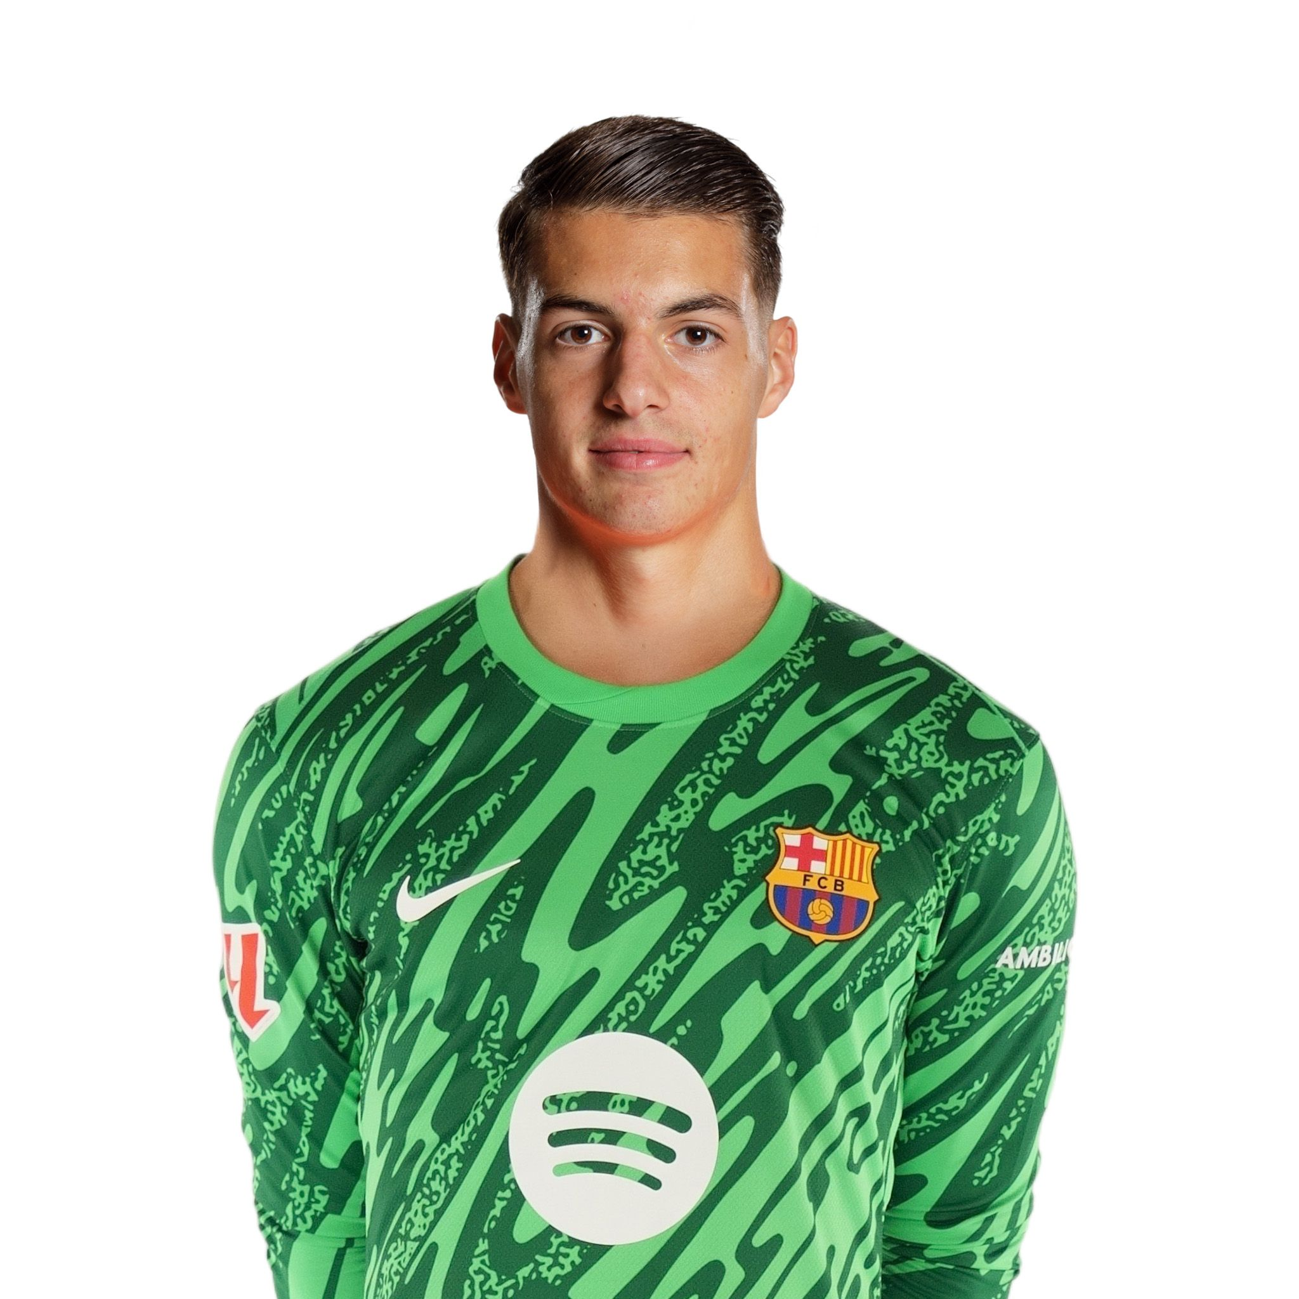
Team Demographics
Youngest by nationality
 | Leon Opitz | 18 | Germany
 | Dominic Martins | 19 | Portugal
 | Francesco Camarda | 15 | Italy
 | Aron Yaakobishvili | 19 | Hungary

Slide 7
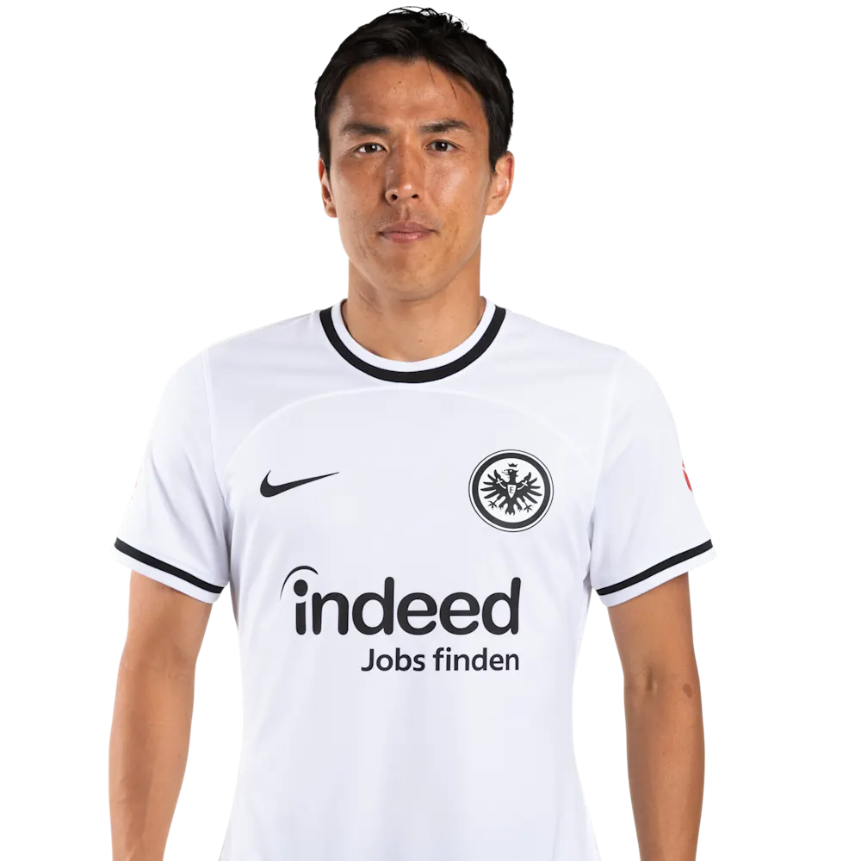
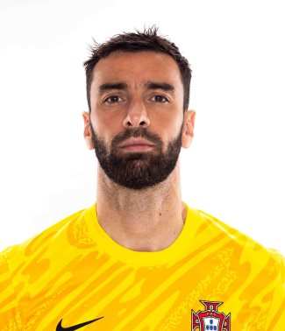
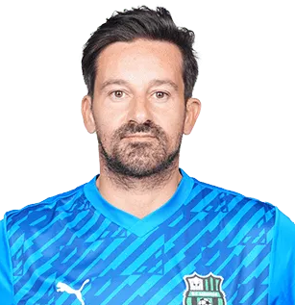

Team Demographics
Oldest by nationality
 | Makoto Hasebe | 40 | Germany
 | Rui Patricio | 37 | Portugal
 | Gianluca Pegolo | 44 | Italy
 | Peter Gulacsi | 35 | Hungary

Slide 8


Goals
MOST
96
LEAST
26
Premier
1246
La Liga
1005
Serie A
992
Bundesliga
985
Manchester City
Cadiz CF
Ligue 1
826
2,88
Average goals per match

Slide 9
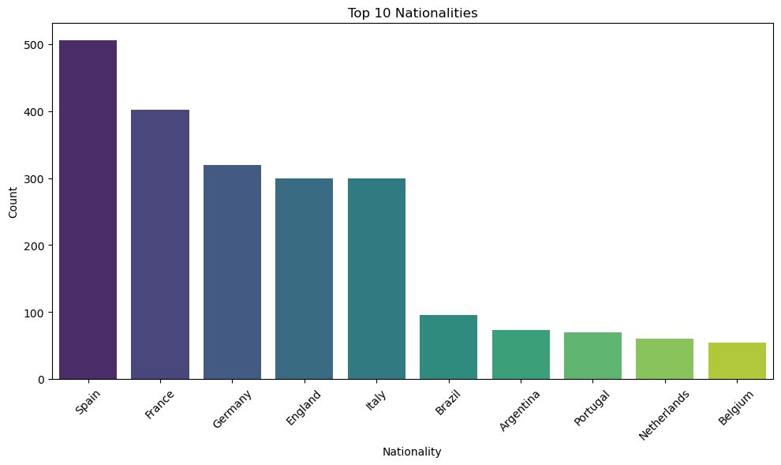
General Statistics
Spain, France and Germany are the top 3 nationalities

Slide 10
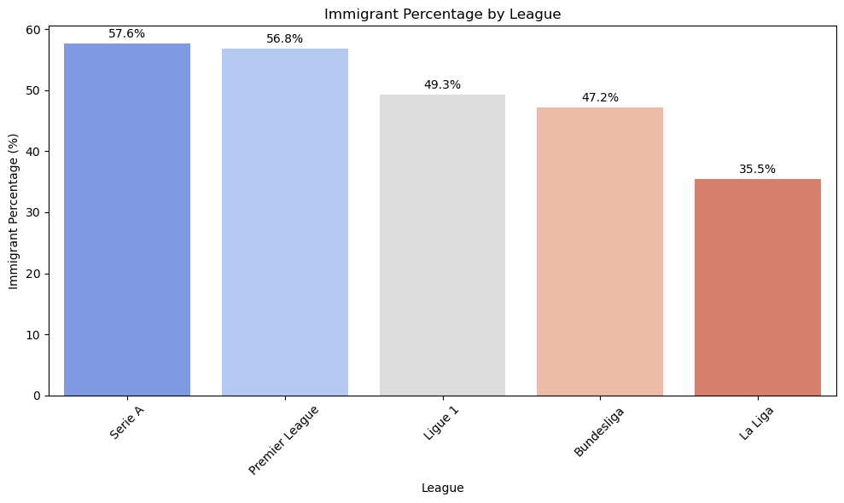
General Statistics
Italy (Serie A) league shows the highest percentage of foreign players, closely followed by England
Spain (La Liga) has the least foreign players

Slide 11
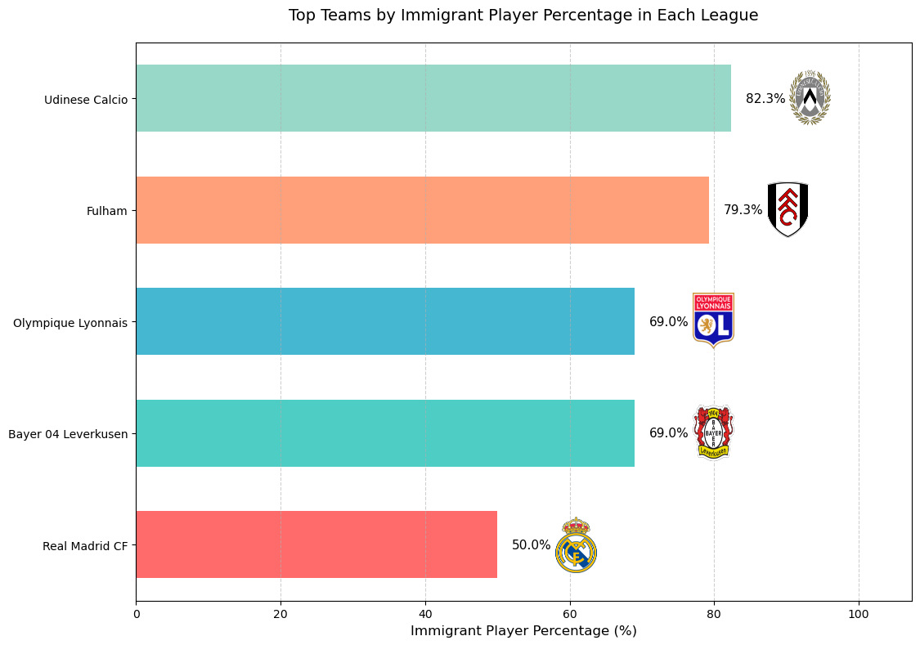

Slide 12
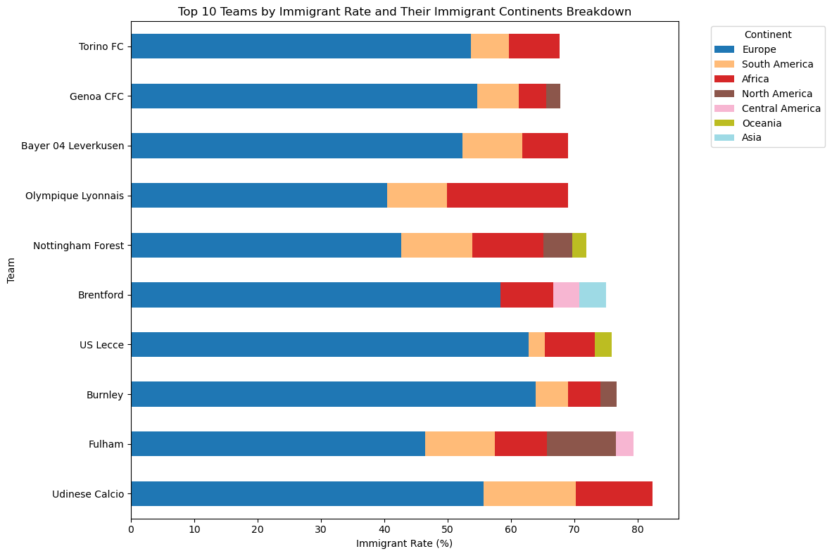

Slide 13
Immigrants by continent
2,4%
58%
Europe
North America
2,1%
1,3%
Asia
Central America
15,5%
0,5%
South America
20,3%
Oceania
Africa

Slide 14

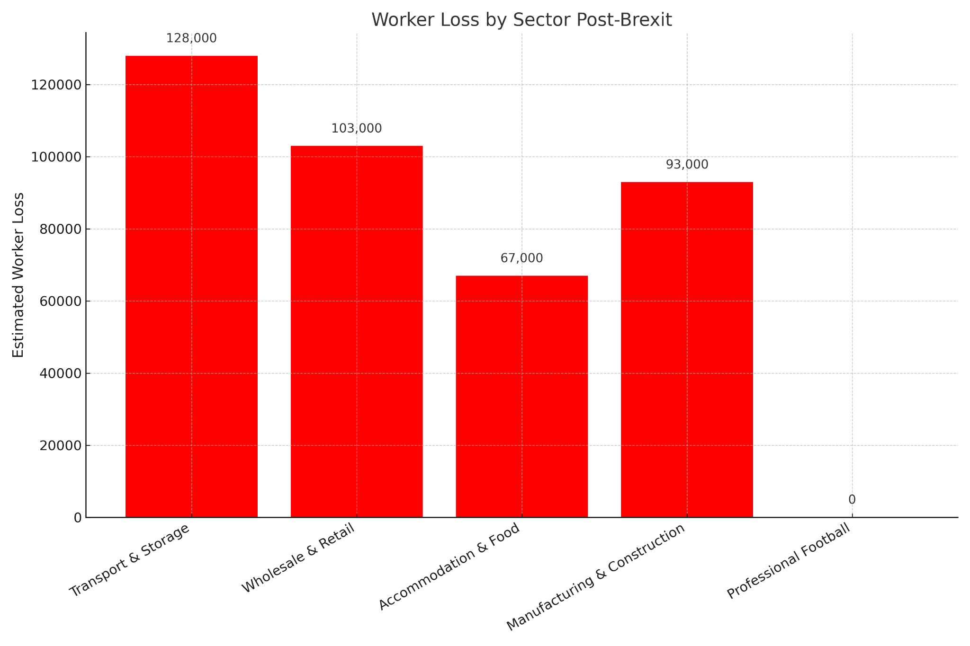

Slide 15

Insights
Our football database revealed key insights and stats for the 2023-24 leagues
We explored practical uses of Workbench and connected our data with VS Code
We encountered some GitHub glitches and successfully resolved them
Adam started liking football more through stats
Heitor started trusting less in free databases

Slide 16


OUR TEAM
Heitor Saldanha
Adam Püspök

